Slide 1
Facial Detection
Jianxing Lu
Wenjin Cao

Slide 2
Motivation
Inspired by Kaggle.com facial detection competition
The suitability of Actors handling multithreads
Notes:
First, we got the idea of facial detection from Kaggle.com, but we decided to only do a real-time version, since we found that scala works well for dealing with mutilthread and we could use akka streams to implement the detection in parallel.

Slide 3
Use Cases
To Detect Faces And Offer Webcam Effects (e.g. to add a pair of glasses on user’s face)
To Analyze Facial Expressions (e.g. to detect smiles potentially)
Notes:
What we did is an app for detecting faces and eyes using webcam.
It has some use cases, like to offer fun webcam effects, and to analyze facial expressions. We actually tried to also detect smiles, but to be honest the precision is way too low. We just spot how many faces or eyes there are Dynamically

Slide 4
Tools : OpenCV|JavaCV
OpenCV (Open Source Computer Vision) is a library of programming functions mainly aimed at real-time computer vision.
The library has more than 2500 optimized algorithms which can be used to detect and recognize faces, identify objects, etc.
JavaCV is a wrapper of OpenCV with easy-to-use methods.
(Java interface to OpenCV and more.)
Notes:
Here are the tools that we used.
We used OpenCV which is a library of functions for real-time detection.
And we used JavaCV as a wrapper of OpenCV which has similar methods but are easier for us to use.

Slide 5
Tools : HAAR Classifiers
HAAR FEATURE-BASED CASCADE CLASSIFIERS
-- Supported directly by OpenCV to detect objects in images
-- A machine learning based approach with pre-trained classifiers
-- “CASCADE” : Instead of applying all the features at once, group the features into different stages of classifiers and apply one-by-one. Only if the previous stage is passed, the next stage is applied and the process is continued.
(An area/object is considered to test positive (be identified) if all features in all stages of the definition return positive.)
Notes:
To be exact, we used the Haar classifiers which are feature-based cascade classifiers supported directly by OpenCV to detect objects in images.

Slide 6
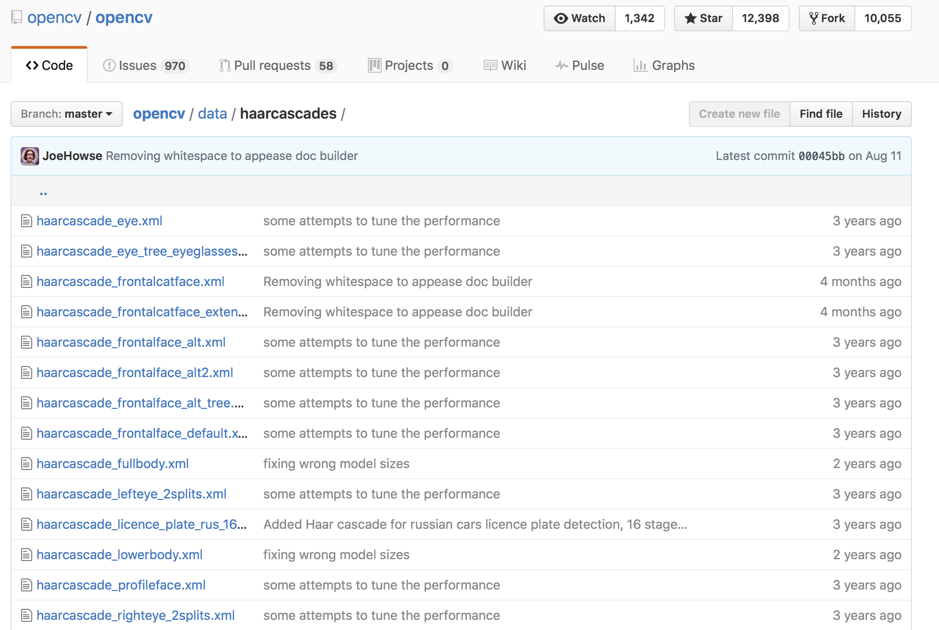
Tools : HAAR Classifiers
OpenCV has
many pre-trained
HAAR classifiers
for frontal/profile
face, eyes, etc.
We got those XML
files from Github:
It’s also possible to
self-train a classifier,
though we used these
pre-trained ones for
time’s sake.
Notes:
Well, they look like this. We got these xml files from github, so we can use these pre-trained classifiers for detecting eyes, frontal faces, profile faces, etc.

Slide 7
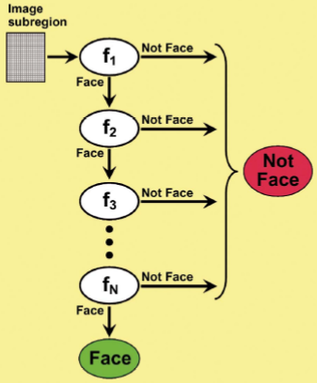
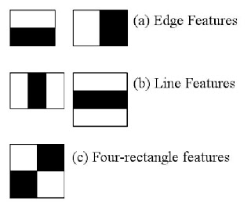
Tools : HAAR Classifiers
“CASCADE”
A ‘cascade’ is a series of
‘Haar-like features’ (digital
image features used in
object recognition) to form
a classifier.
Instead of applying all the features at once, group the features into different stages of classifiers and apply one-by-one. Only if the previous stage is passed, the next stage is applied and the process is continued.
Notes:
As for the concept of cascade, it is a series of features which are
As shown in the picture in the left bottom.
The cascade classifiers work like stages as shown in the right picture

Slide 8
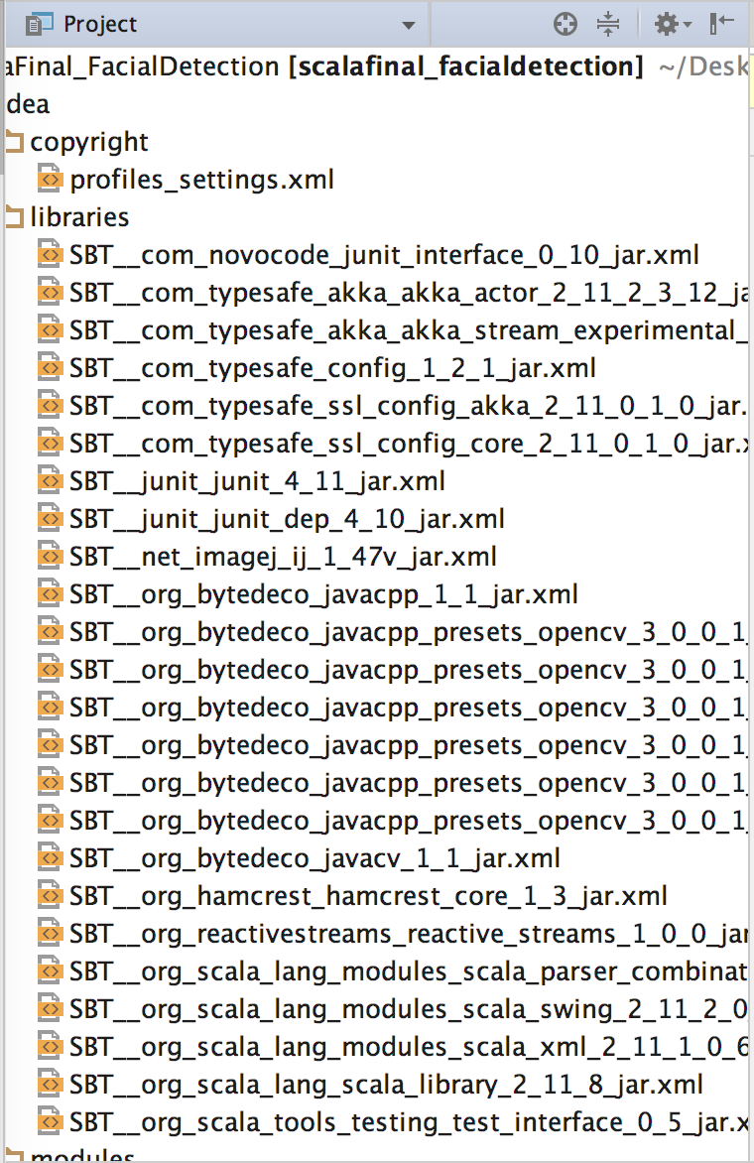
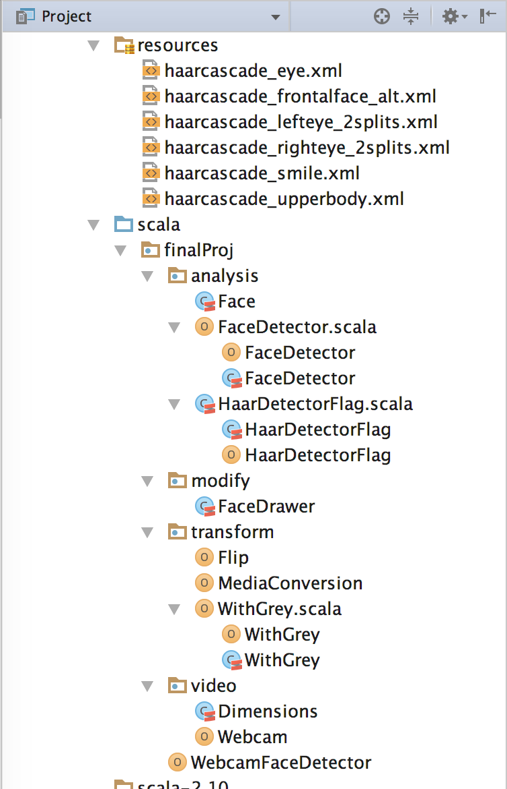
SBT-based Scala Project
Notes:
Now let’s come to our sbt project.

Slide 9
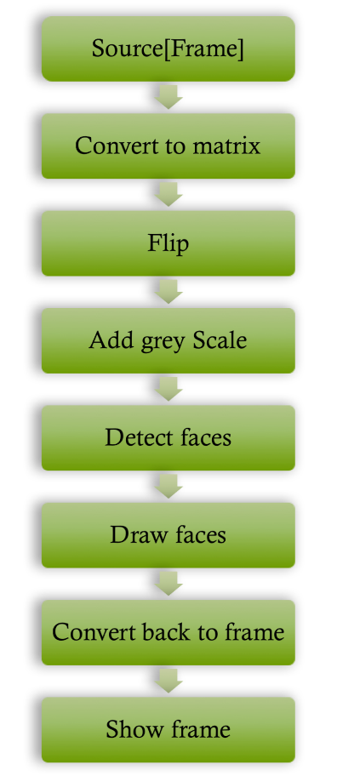
Flow Chart
Conversion to grey scale :
Many image analysis tools need to be run on greyscale images, both for simplicity and efficiency.
To detect faces :
Instantiating a CascadeClassifier
Instantiating an instance of RectVector (a wrapper for a native vector of rectangles to denote where our objects are in the image matrix).
Pass the RectVector to the CascadeClassifier along with a greyscale image and some other options
A Swing app :
1st frame: to choose between loading a custom Haar cascade classifier file or to load the default one that’s packaged in resources folder
2nd frame: to shows our feed along with rectangles around detected objects in the CanvasFrame
Notes:
Here’s the flow chart of how we implemented the app.
For details, We treated the images as matrix and converted it to grey scale for more efficient analysis.
We built a webcam object using AKKA source and JavaCV frame.

Slide 10
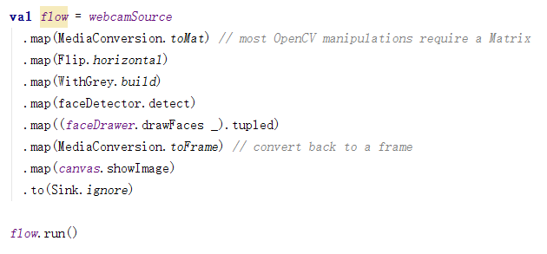
Implementation of Flow Chart
Notes:
We use mediaconversion class to implement the transformation between frame and matrix in order to fulfill the input requirement for opencv. And using flip function to set the parameter as 1 to flip the frame, otherwise the picture captured by webcam will go upside down, then WithGrey method can change the image to grey and enhance the efficiency of facial detection by reducing the bad effect coming from multiple colors. We use facedetector and face drawer to add rectangle around the elements we identified with number, at last, we show the frame in application by canvas.showImage method.

Slide 11
AKKA for Webcam Frame
-- Reactive Stream
akka.stream.scaladsl.Source<Out,Mat> -- Source[Frame, Unit]. A set of stream processing steps that has one open output(JavaCV Frame).
akka.actor.Props -- To configure the creation of the actor
akka.stream.actor.{ActorPublisher, ActorMaterializer}
- To make the actor a stream publisher that keeps track of the subscription life cycle and requested elements.
- Materialization turns a Source into a Reactive Streams Publisher
akka.stream.scaladsl.Sink -- A Sink is a set of stream processing steps that has one open input and an attached output.
IMPLEMENTATION of AKKA:
Mainly used in Webcam class by generated a ActorSystem
Utilized FrameGrabber to avoid bad things happens like video not be synchronized
Designed a lazy WebcamFramePublisher to work with grabber
Notes:
Reactive Streams is an initiative to provide a standard for asynchronous stream processing with non-blocking back pressure.

Slide 12
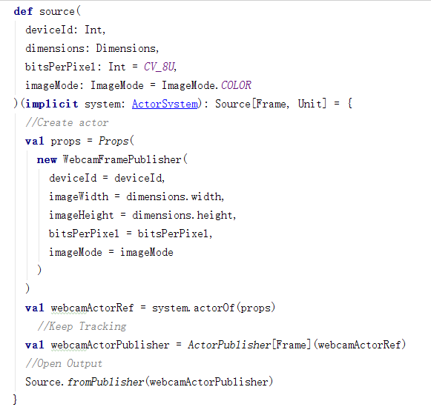

Slide 13
Demo Time
Function 1: Face only detection
Function 2: Eyes detection
Function 3(main function): Facial detection of number of faces with left and right eye
Notes:
Due to open cv is a facial detection library for images, we use akka to create stream detection function in our project, the basic principle is capturing several images as a stream, so we have to do unlimited detection of images, the ram of jvm is the key problem here. To avoid this drawback, we have to release the ram manually or increase our local ram. We configured the jvm option during runtime in itellij. However, detecting three elements at one time is still to hard for our computer, it’s still easy to crash.

Slide 14
Further Work…
For blocking and heap overflow issues
1. Using one specific ActorSystem to handle those operations
2. Using Future to complete the block and set the limit of those kind of blocks
3. Defining one Actor to deal with a group of resource which could be blocked.

